Slide 1
CE80362 : Circuit Analysis
Lecture 2:
Basic Preliminaries on Circuit Analysis, Mesh (loop) and Nodal Analysis.

Slide 2
Basic Preliminaries on Circuit Analysis
Series Circuits
An electric circuit is the combination of any number of sources and loads connected in any manner that allows charge to flow.
The electric circuit may be simple, such as a circuit consisting of a battery and a light bulb or complex. All electric circuits obtain their energy either from a direct current (dc) source or from an alternating current (ac) source.
Although ac circuits have fundamental differences when compared with dc circuits, the laws, theorems, and rules that you learn in dc circuits apply directly to ac circuits as well.

Slide 3
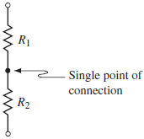
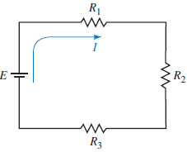
A series circuit is constructed by combining various elements in series.
    Two elements are said to be in series if they are connected at a single point and if there are no other current-carrying connections at this point.
    The current is the same everywhere in a series circuit.
Resistors in series.
Series circuit.

Slide 4
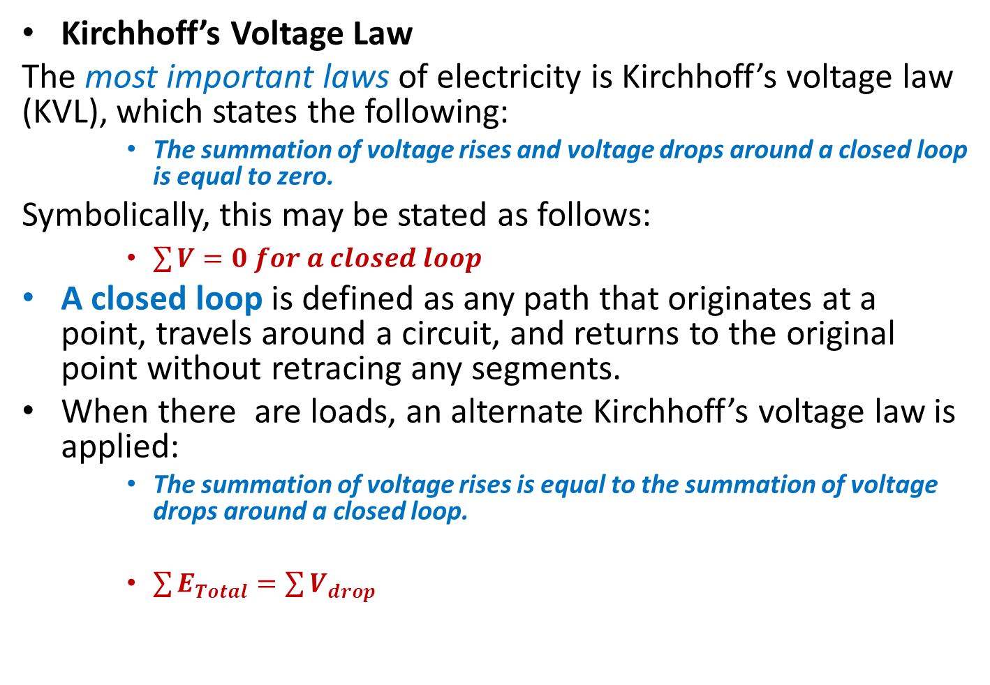
Kirchhoff’s Voltage Law
The most important laws of electricity is Kirchhoff’s voltage law (KVL), which states the following:
    The summation of voltage rises and voltage drops around a closed loop is equal to zero.
Symbolically, this may be stated as follows:
    $\sum{V}=0 for a closed loop$
A closed loop is defined as any path that originates at a point, travels around a circuit, and returns to the original point without retracing any segments.
When there are loads, an alternate Kirchhoff’s voltage law is applied:
    The summation of voltage rises is equal to the summation of voltage drops around a closed loop.
    $\sum{E_{Total}}=\sum{V_{drop}}$

Slide 5
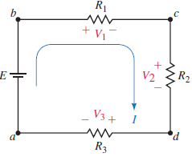
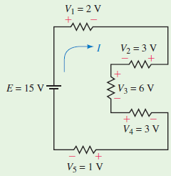
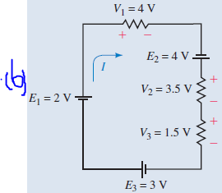

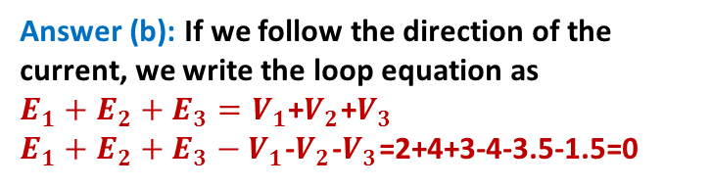
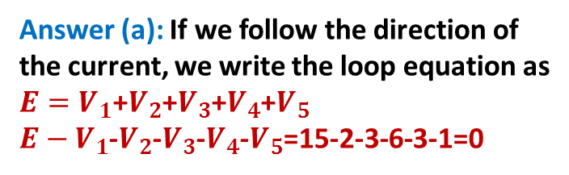
Example1
Example2: Verify Kirchhoff’s voltage law for the following circuits.
(a)
$E=V_{1}$+$V_{2}$+$V_{3}$
The voltage dropped across the resistors react in opposite direction compared to the direction of the source.
Answer (a): If we follow the direction of the current, we write the loop equation as
$E=V_{1}$+$V_{2}$+$V_{3}$+$V_{4}$+$V_{5}$
$E−V_{1}$-$V_{2}$-$V_{3}$-$V_{4}$-$V_{5}$=15-2-3-6-3-1=0
Answer (b): If we follow the direction of the current, we write the loop equation as
$E_{1}+E_{2}+E_{3}=V_{1}$+$V_{2}$+$V_{3}$
$E_{1}+E_{2}+E_{3}−V_{1}$-$V_{2}$-$V_{3}$=2+4+3-4-3.5-1.5=0

Slide 6

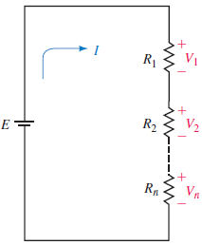
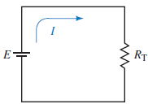

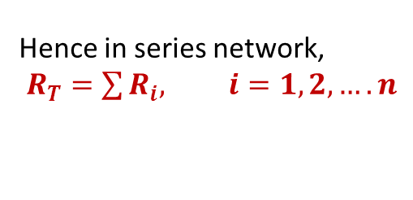

Resistors in Series
Since the circuit is a closed loop, the voltage source will cause a current I in the circuit. This current in turn produces a voltage drop across each resistor, where
    $V_{x}={IR}_{x}$
Applying Kirchhoff’s voltage
law to the closed loop gives:
If we were to replace all the resistors of fig. (a) with a total equivalent resistance, RT, then the circuit would appear as in fig.(b)
Hence in series network,
$R_{T}=\sum{R_{i}, i=1,2,….n}$
(b)

Slide 7
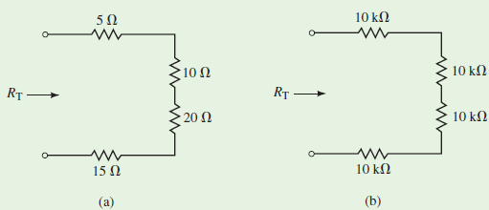
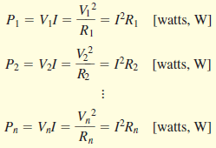

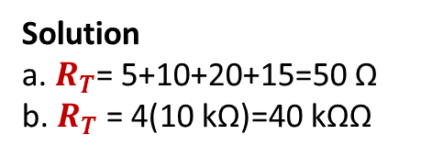
Examples: Determine the total resistance for each of the following networks
The power dissipated by each resistor is:
Hence, $P_{T}=EI$, with E=V1+V2+…+Vn
PT=P1+P2+…..+Pn
Solution
a. $R_{T}$= 5+10+20+15=50 Ω
b. $R_{T}$ = 4(10 kΩ)=40 kΩΩ
Any voltage source connected to the terminals of a network of series resistors will provide the same current as if a single resistance, having a value of RT, hence I= $\frac{E}{R_{T}}$ (Ohm’s law)
Meaning that energy must be conserved, the power delivered by the voltage source is equal to the total power dissipated by all the resistors.

Slide 8
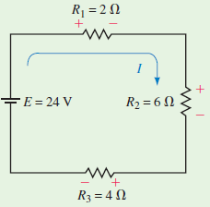
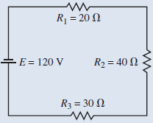
Example for Enhancement (1) :
(a) For the series circuit shown in Fig. (a), find the following quantities:
Total resistance, RT
Circuit current, I.
Voltage across each resistor
Power dissipated by each resistor.
Power delivered to the circuit by the voltage source.
Verify that the power dissipated by the resistors is equal to the power delivered to the circuit by the voltage source.
(a)
(b) For the series circuit shown in Figure (b), find the following quantities:
Total resistance, RT.
The direction and magnitude of the current, I.
Polarity and magnitude of the voltage across each resistor.
Power dissipated by each resistor.
Power delivered to the circuit by the voltage source.
Show that the power dissipated is equal to the power delivered.
(b)

Slide 9
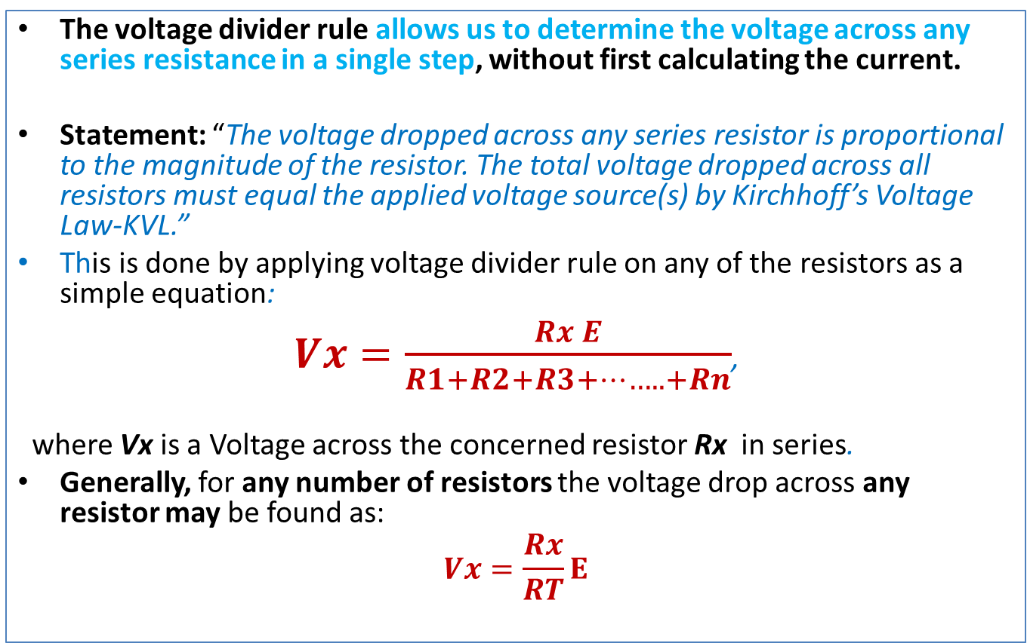
The Voltage Divider Rule
The voltage divider rule allows us to determine the voltage across any series resistance in a single step, without first calculating the current.
Statement: “The voltage dropped across any series resistor is proportional to the magnitude of the resistor. The total voltage dropped across all resistors must equal the applied voltage source(s) by Kirchhoff’s Voltage Law-KVL.”
This is done by applying voltage divider rule on any of the resistors as a simple equation:
$Vx=\frac{Rx E}{R1+R2+R3+……..+Rn}$,
where Vx is a Voltage across the concerned resistor Rx in series.
Generally, for any number of resistors the voltage drop across any resistor may be found as:
$$Vx=\frac{Rx}{RT}E$$

Slide 10
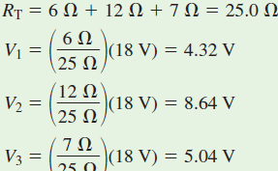
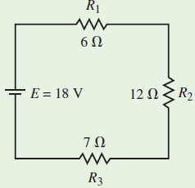
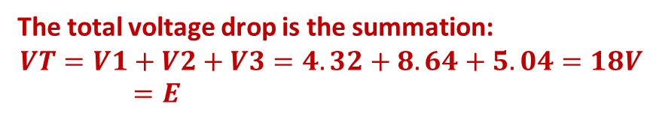
Example (1): Use the voltage divider rule to determine the voltage across each of the resistors in the circuit shown below. Show that the summation of voltage drops is equal to the applied voltage rise in the circuit.
Solution
The total voltage drop is the summation:
$$VT=V1+V2+V3=4.32+8.64+5.04=18V=E$$

Slide 11
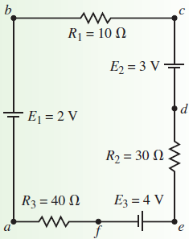
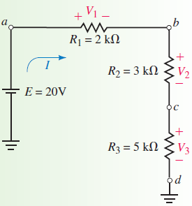
Example for Enhancement (2) :
(1) Apply the Voltage divider rule
to determine the following
voltages: Vac, Vad, Vcf, and Veb.
(2) Applying the voltage divider rule to determine the voltages Va, Vb, Vc, and Vd.

Slide 12
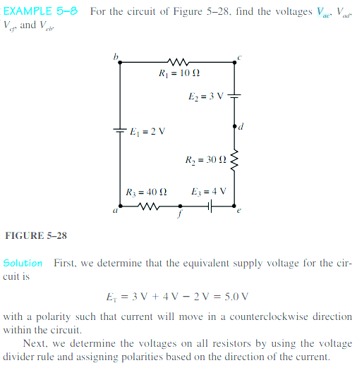

Slide 13
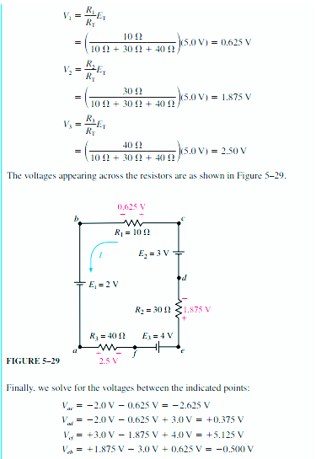

Slide 14
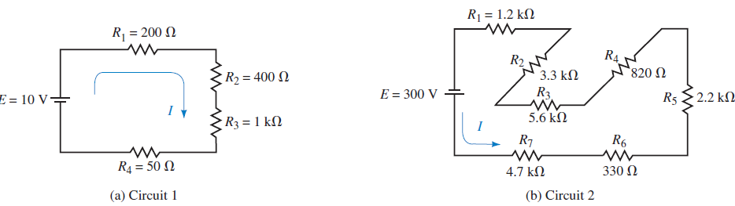
Tutorials
For the circuits shown in Fig.1, determine the total resistance, RT, and the current, I.
Fig.1

Slide 15
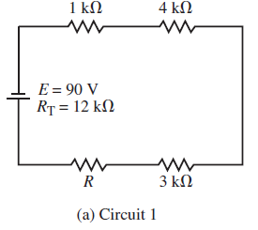
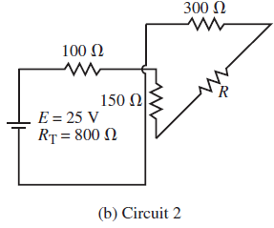
2. The circuits of Fig.2 have the total resistance, RT, as shown. For each of the circuits find the following:
The magnitude of current in the circuit.
The total power delivered by the voltage source.
The direction of current through each resistor in the circuit.
The value of the unknown resistance, R.
The voltage drop across each resistor.
The power dissipated by each resistor. Verify that the summation of powers dissipated by the resistors is equal to the power delivered by the voltage source.
Fig.2

Slide 16
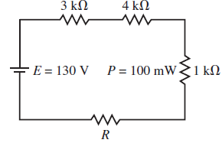
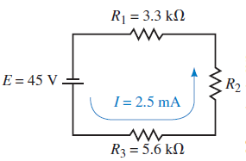
3. For the circuit of Fig.3, find the following quantities:
a. The circuit current.
b. The total resistance of the circuit.
c. The value of the unknown resistance, R.
d. The voltage drop across all resistors in the circuit.
e. The power dissipated by all resistors.
Fig.3
4. The circuit of Fig.4 has a current of 2.5 mA. Find the following
quantities:
a. The total resistance of the circuit.
b. The value of the unknown resistance, R2.
c. The voltage drop across each resistor in the circuit.
d. The power dissipated by each resistor in the circuit.
Fig.4

Slide 17
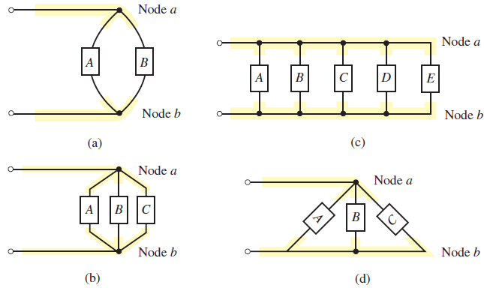
PARALLEL CIRCUITS
Elements or branches are said to be in a parallel connection when they have exactly two nodes in common. Additionally, these parallel elements or branches will have the same voltage across them.
The elements between the nodes may be any two-terminal devices such as voltage sources, resistors, light bulbs, etc.
Parallel elements.

Slide 18
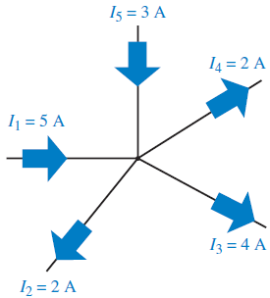

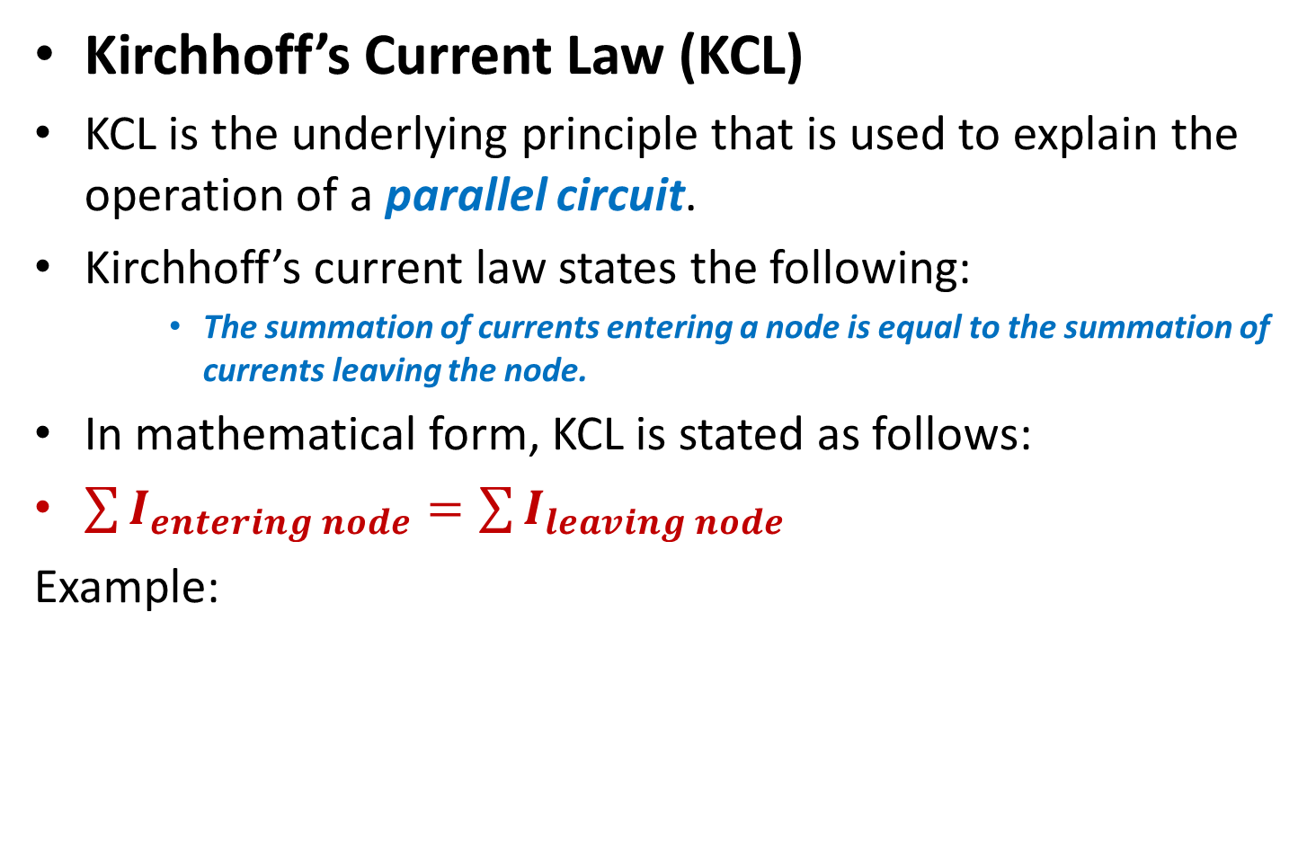
Kirchhoff’s Current Law (KCL)
KCL is the underlying principle that is used to explain the operation of a parallel circuit.
Kirchhoff’s current law states the following:
    The summation of currents entering a node is equal to the summation of currents leaving the node.
In mathematical form, KCL is stated as follows:
$\sum{I_{entering node}=\sum{I_{leaving node}}}$
Example:

Slide 19
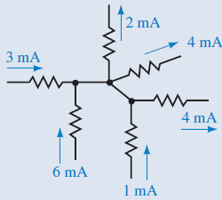
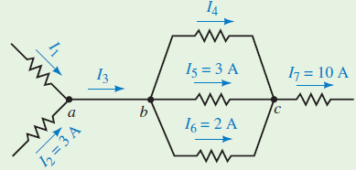
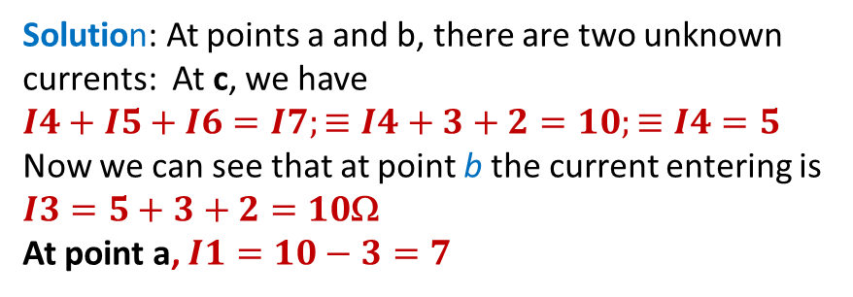
Example1: Verify that Kirchhoff’s current law
Solution: All resistors are connected at the same node
3 mA+ 6mA+1mA=2mA+4mA+4 mA
Example2 Find the magnitudes of the unknown currents.
Solution: At points a and b, there are two unknown
currents: At c, we have
$$I4+I5+I6=I7;≡I4+3+2=10;≡I4=5$$
Now we can see that at point b the current entering is
$I3=5+3+2=10$Ω
At point a, $I1=10−3=7$

Slide 20
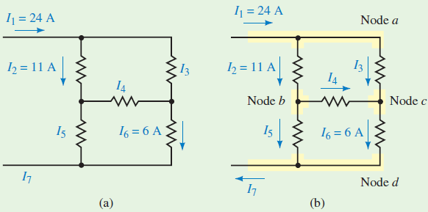
Example for enhancement (3)
Determine the unknown currents in the network.

Slide 21
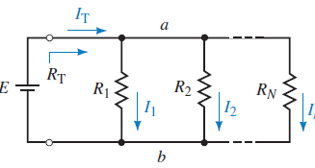
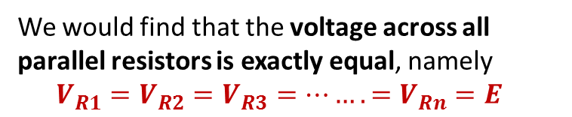
Resistors in Parallel
A simple parallel circuit is constructed by combining a voltage source with several resistors.
The voltage source will result in current from the positive terminal of the source toward node a. At this point the current will split between the various resistors and then recombine at node b before continuing to the negative terminal of the voltage source.
We would find that the voltage across all parallel resistors is exactly equal, namely
$$V_{R1}=V_{R2}=V_{R3}=…….=V_{Rn}{=E}_{}$$

Slide 22

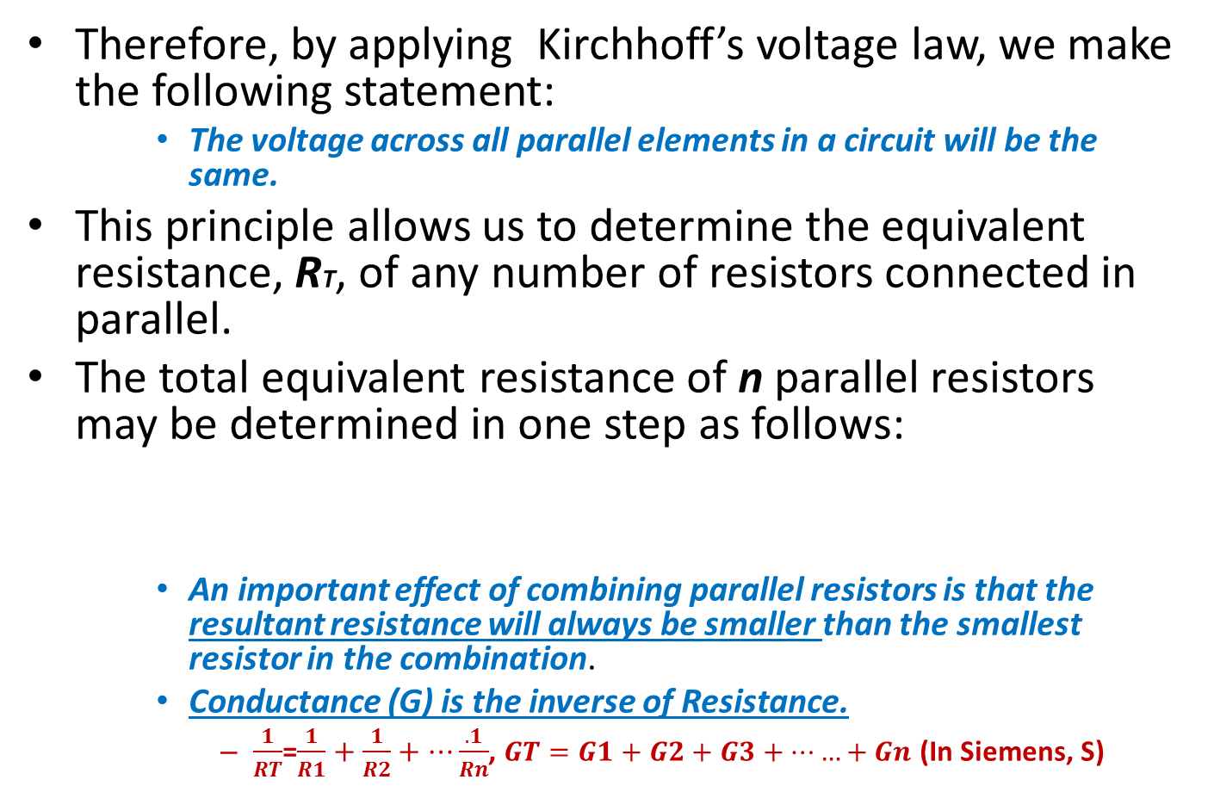
Therefore, by applying Kirchhoff’s voltage law, we make the following statement:
    The voltage across all parallel elements in a circuit will be the same.
This principle allows us to determine the equivalent resistance, RT, of any number of resistors connected in parallel.
The total equivalent resistance of n parallel resistors may be determined in one step as follows:
    An important effect of combining parallel resistors is that the resultant resistance will always be smaller than the smallest resistor in the combination.
    Conductance (G) is the inverse of Resistance.
      $\frac{1}{RT}$=$\frac{1}{R1}+\frac{1}{R2}+…\frac{.1}{Rn}$, $GT=G1+G2+G3+……+Gn$ (In Siemens, S)

Slide 23
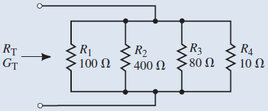

Example: For the parallel network of resistors shown below, find the total conductance GT and the total resistance RT.
If we have n equal resistors in parallel, each resistor, R, has the same conductance G,
The total GT=nGT
The RT=1/GT=1/nG=R/n

Slide 24
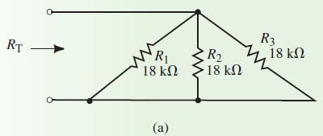

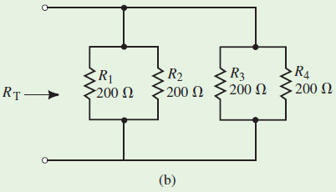

Example: For the following networks, calculate the total resistance.

Slide 25
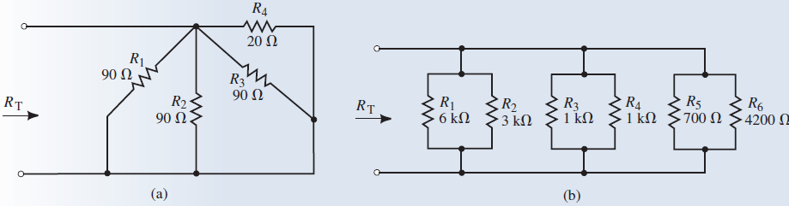
Example for enhancement (4):
Find the total equivalent resistance for each network.

Slide 26
Current Divider Rule
The voltage divider rule (VDR) discussed earlier, was used to determine the voltage across all resistors within a series network.
In parallel networks, the voltage across all parallel elements is the same.
However, the currents through the various elements are typically different.
The current divider rule (CDR) is used to determine how current entering a node is split between the various parallel resistors connected to the node.

Slide 27
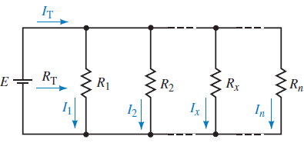
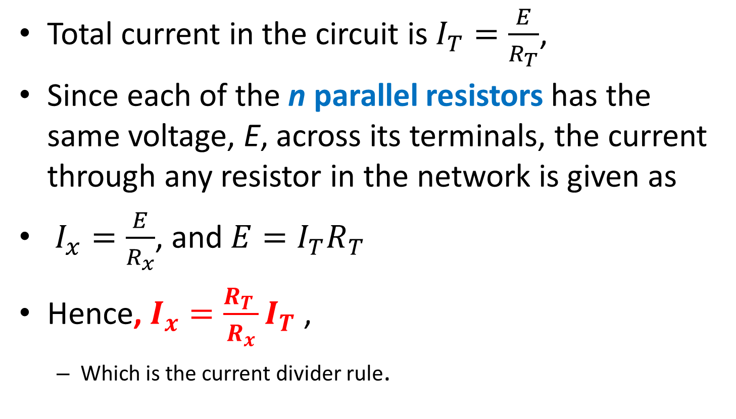
Total current in the circuit is $I_{T}=\frac{E}{R_{T}}$,
Since each of the n parallel resistors has the same voltage, E, across its terminals, the current through any resistor in the network is given as
$I_{x}=\frac{E}{R_{x}}$, and $E=I_{T}R_{T}$
Hence, $I_{x}=\frac{R_{T }}{R_{x}}I_{T}$ ,
  Which is the current divider rule.

Slide 28
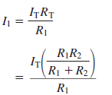


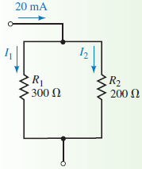
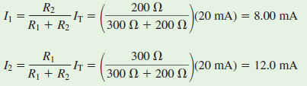

If the network consists of only two parallel resistors, then the current through each resistor may be found in a slightly different way.
Recall that: $R_{T}=\frac{R1×R2}{R1+R2},$Then the Current
Which is simplified as:
Example: Determine the currents I1 and I2 in the network
Solution, Since we have only two resistors, we have:

Slide 29




Example: For this network, determine the currents I1, I2, and I3.
Using conductance G
Solution: We calculate the total conductance of the network.
Using total resistance

Slide 30

Example for enhancement (5)
(1) Use the current divider rule to calculate the unknown currents for the networks below.

Slide 31

Example for enhancement (5)-Cont’
For the circuit of this figure, determine the following quantities:
RT, IT
Power delivered by the voltage source
I1 and I2 using the current divider rule
Power dissipated by the resistors.

Slide 32






The Series-Parallel Network
In analyzing such circuits, it is imperative to remember that the rules for analyzing series and parallel elements still apply.
    The same current occurs through all series elements.
    The same voltage occurs across all parallel elements.
In addition, remember that Kirchhoff’s voltage law and Kirchhoff’s current law apply for all circuits regardless of whether the circuits are series, parallel, or series-parallel.
Example: (a) Find RT, (b) Calculate I1, I2, and I3, (c) The voltages V1 and V2.

Slide 33
Source Transformation
As you recall, voltage sources always have some series resistance, although in some cases this resistance is so small in comparison with other circuit resistance that it may effectively be ignored when determining the operation of the circuit.
Similarly, a constant-current source will always have some shunt (or parallel) resistance.
If this resistance is very large in comparison with the other circuit resistance, the internal resistance of the source may once again be ignored.
An ideal current source has an infinite shunt resistance.

Slide 34


If the internal resistance of a source is considered, the source, whether it is a voltage source or a current source, is easily converted to the other type.
In this fig. the current source is equivalent to the voltage source if $I=\frac{E}{Rs}$ , and the resistances in both cases is RS.
Similarly, a current source
may be converted to an
equivalent voltage source
by letting $E=IRs$

Slide 35








These results may be easily verified by connecting an external resistance, RL, across each source.
The sources can be equivalent only if the voltage across RL is the same for both sources.
Similarly, the sources are equivalent only if the current through RL is the same when connected to either source.
Therefore, Considering Fig. (a), VL and IL are given by:
Considering Fig. (b), and by converting the source we get
and , and so we have
The voltage across the resistor is given as
Fig.(a)
Which is precisely the same as the result obtained in Fig. (a).
Fig.(b)

Slide 36






Example1: Convert the voltage source of fig.(a) into a current source and verify that the current, IL, through the load is the same for each source.
Fig. (a)
Solution
Fig. (b)
The equivalent current source will have a current magnitude given as: and the current through the load in Fig (a) is found as:
Also, the current through the load of Fig. (b) is: $I_{L}\frac{Rs}{Rs+Rl}I_{T}$
Hence, Clearly the results are the same.

Slide 37
Example for Enhancement:
Reduce the following circuit by using the source transformation method. Also calculate the current and the voltage dropped in the resistor(s) of the final reduced circuit

Slide 38
Mesh (loop) and Nodal Analysis.

Slide 39
Methods of Analysis to solve Branch-current ckts.
Main Steps:
Arbitrarily assign current directions to each branch in the network.
Using the assigned currents directions, label the polarities of the voltage drops across all resistors in the circuit.
Apply Kirchhoff’s voltage law around each of the closed loops. Write just enough equations to include all branches in the loop equations.
Apply Kirchhoff’s current law at enough nodes to ensure that all branch currents have been included. In the event that a branch has only a current source, it will need to be included in this step.
Solve the resulting simultaneous linear equations.

Slide 40

Example Find the current in each branch in the circuit of the following figure:
Solution
Step 1: Assign currents directions as shown in Fig.(a).
Step 2: Indicate the polarities of the voltage drops on all resistors in the circuit, using the assumed current directions.
Step 3: Write the Kirchhoff voltage law equations.
Fig. (a)

Slide 41

Identify loops and Apply KVL
We have 2 loops: Loop abcda and cefdc (or abcefda):
Loop abcda:
Loop cefdc:
Now, all branches have been included in the loop equations, there is no need to write any more.
Step 4: Write the Kirchhoff current law equation(s).

Slide 42


By applying KCL at node c, all branch currents in the network are included.
    I3=I1+I2
To simplify the solution of the simultaneous linear equations we write them as follows:
By using determinant (matrix) method, we have
By solving for the currents, we have:
I1=1.200A
I2=0.200A
I3=1.400A

Slide 43


Examples for Enhancement:
Find the currents in each branch of the circuit shown in Fig.(1). Solve for the voltage Vab.
Fig. (1)
(2) Use branch-current analysis to solve
for the indicated currents
in the circuit of Fig. (2) Fig. (2)

Slide 44
Mesh (Loop) Analysis
The best approach to analyze the Branch-current circuits is to use “mesh (or loop) analysis”.
The principal difference between mesh analysis and branch-current analysis is that we simply need to apply KVL around closed loops without the need for applying KCL.

Slide 45
Steps:
Arbitrarily assign a clockwise current to each interior closed loop in the network. Although the assigned current may be in any direction, a clockwise direction is used to make later work simpler.
Using the assigned loop currents, indicate the voltage polarities across all resistors in the circuit. For a resistor that is common to two loops, the polarities of the voltage drop due to each loop current should be indicated on the appropriate side of the component.
Applying KVL, write the loop equations for each loop in the network. Do not forget that resistors that are common to two loops will have two voltage drops, one due to each loop.
Solve the resultant simultaneous linear equations.
Branch currents are determined by algebraically combining the loop currents that are common to the branch.

Slide 46

Example:
Find the current in each branch for the circuit below.
Solution
Step 1: Loop currents I1 and I2 are assigned as shown above.
Step 2: Voltage polarities are assigned according to the loop currents. Notice that
the resistor R2 has two different voltage polarities due to the different loop currents.
Step 3: The loop equations are written by applying Kirchhoff’s voltage law in
each of the loops. The equations are as follows:

Slide 47


The preceding loop equations may be simplified as follows:
The branch current for R2 is found by combining the loop currents through this resistor:

Slide 48
The results obtained by using mesh analysis are exactly the same as those obtained by branch-current analysis.
However, branch-current analysis required three equations;
While Mesh (Loop) approach requires the solution of only two simultaneous linear equations.
Hence, Mesh analysis is preferred to branch-current analysis.
If the circuit being analyzed contains current sources, the circuit may be simplified by converting the current source(s) to voltage sources and then solving the resulting network using the previous procedure.

Slide 49



Example: Determine the current through the 8V battery for the following circuit.
Converted voltage source
After converting the current source into an equivalent voltage source. The equivalent circuit may now be analyzed by using the loop currents as shown below:
Solution
Only two loops

Slide 50


Slide 51



Example for Enhancement.
Solve for the currents through R2 and R3 in the fig. (1) circuit
(2) Use mesh analysis to find the loop currents in Fig. (2).
fig. (1)
Hint: Converted voltage source
Fig. (2).

Slide 52
Nodal Analysis
In Nodal analysis, we will apply KCL to determine the potential difference (voltage) at any node with respect to some arbitrary reference point in a network.
The steps to follow:
Arbitrarily assign a reference node within the circuit and indicate this node as ground.
Convert each voltage source in the network to its equivalent current source. This step, although not absolutely necessary, makes further calculations easier to understand.

Slide 53
3. Arbitrarily assign voltages (V1, V2, . . . , Vn) to the remaining nodes in the circuit.
4. Arbitrarily assign a current direction to each branch in which there is no current source and indicate the corresponding polarities of the voltage drops on all resistors.
5. With the exception of ground, apply KCL at each of the nodes. If a circuit has a total of n+1 nodes (including the reference node), there will be n simultaneous linear equations.
6. Rewrite each of the arbitrarily assigned currents in terms of the potential difference across a known resistance.
7. Solve the resulting simultaneous linear equations for the voltages (V1,V2, . . . , Vn).

Slide 54


Example: Given this circuit, use nodal analysis to solve for the voltage V_{ab}.
I=V/R=6/30=0.2 A or 200mA
Converted Current source

Slide 55


Solution
Step 1: Select a convenient reference node (ground).
Step 2: Convert the voltage sources into equivalent current sources. The equivalent circuit is shown on the right side.
Steps 3 and 4: Arbitrarily assign node voltages and branch currents. Indicate the voltage polarities across all resistors according to the assumed current directions.
Step 5:We now apply Kirchhoff’s current law at the nodes labelled as V1 and

Slide 56





Using nodal method, the currents are rewritten in terms of the voltages across the resistors as follows:
The nodal equations become:
Substituting the voltage expressions into the original nodal equations, we have:
Hence, solving simulteneously, the voltage V2 is the same as the voltage Va, namely:
Therefore, the voltage Vab is simply found as:

Slide 57


Slide 58



Example for Enhancement:
Determine the nodal voltages for the circuit shown.
Use nodal analysis to find the nodal voltages for this circuit. Use the answers to solve for the current through R1.
Hint: converted current source

Slide 59
Assignment 1
With atleast 2 circuit examples explain the nodal mesh (loop)analysis in circuit analysis

Slide 60
Next Class:
Network Theorems

